Slide 1
Constituency Parser Evaluation

Slide 2
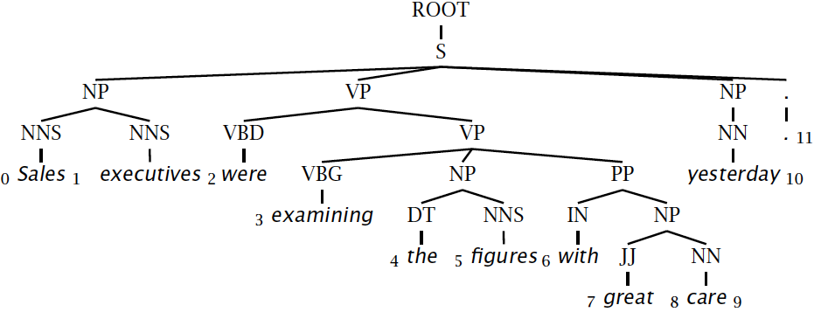
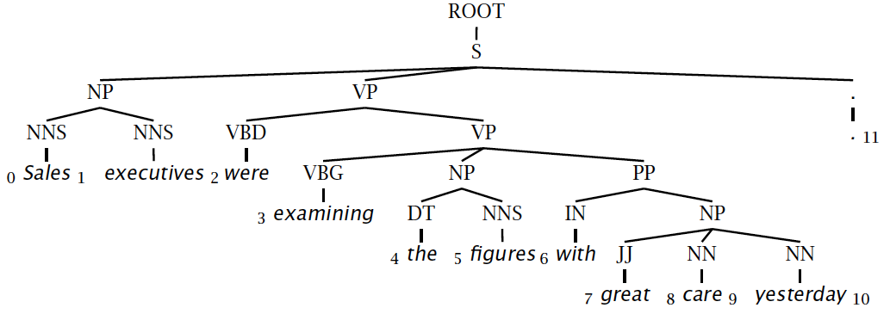
Evaluating constituency parsing
Notes:
Most sentences are not given a completely correct parse by any currently existing parser.
A constituent is a triple, which must be exact in the true parse for the constituent to be marked correct.

Slide 3
Evaluating constituency parsing
Gold standard brackets:
S-(0:11), NP-(0:2), VP-(2:9), VP-(3:9), NP-(4:6), PP-(6-9), NP-(7,9), NP-(9:10)
Candidate brackets:
S-(0:11), NP-(0:2), VP-(2:10), VP-(3:10), NP-(4:6), PP-(6-10), NP-(7,10)
Labeled Precision 3/7 = 42.9%
Labeled Recall 3/8 = 37.5%
LP/LR F1 40.0%
Tagging Accuracy 11/11 = 100.0%
Notes:
This isn’t necessarily a great measure … me and many other people think dependency accuracy would be better.

Slide 4
How good are PCFGs?
Penn WSJ parsing accuracy: about 73% LP/LR F1
Robust
Usually admit everything, but with low probability
Partial solution for grammar ambiguity
A PCFG gives some idea of the plausibility of a parse
But not so good because the independence assumptions are too strong
Give a probabilistic language model
But in the simple case it performs worse than a trigram model
The problem seems to be that PCFGs lack the lexicalization of a trigram model

Slide 5
Constituency Parser Evaluation

